Slide 1


Slide 2


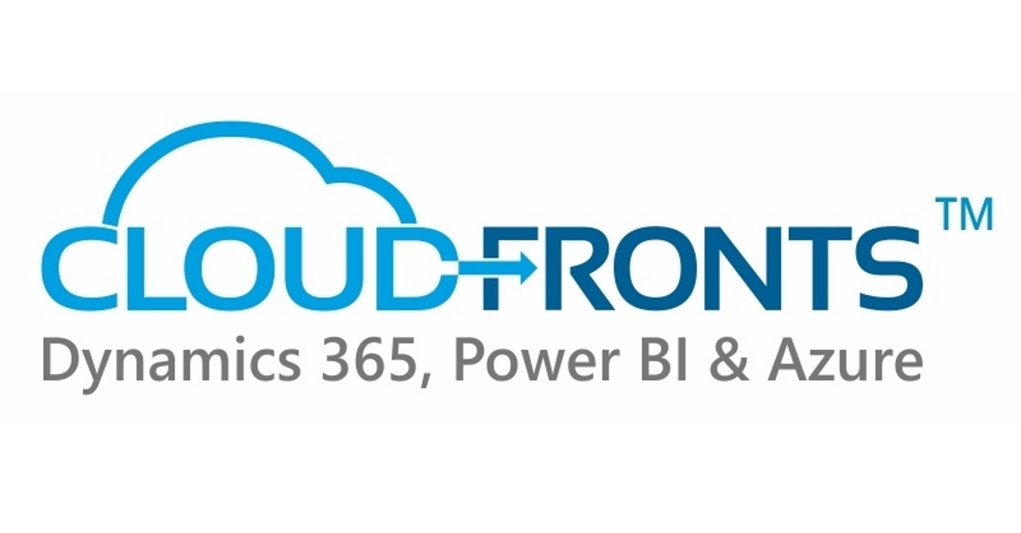

Blog: https://olisterr.tech/

Slide 3
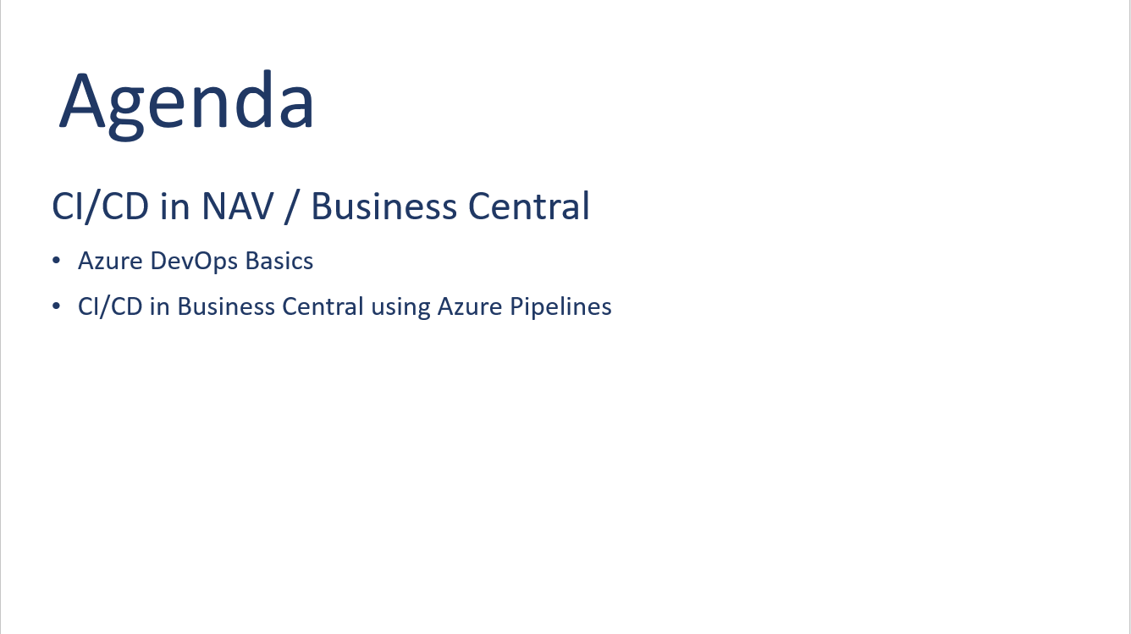

Slide 4
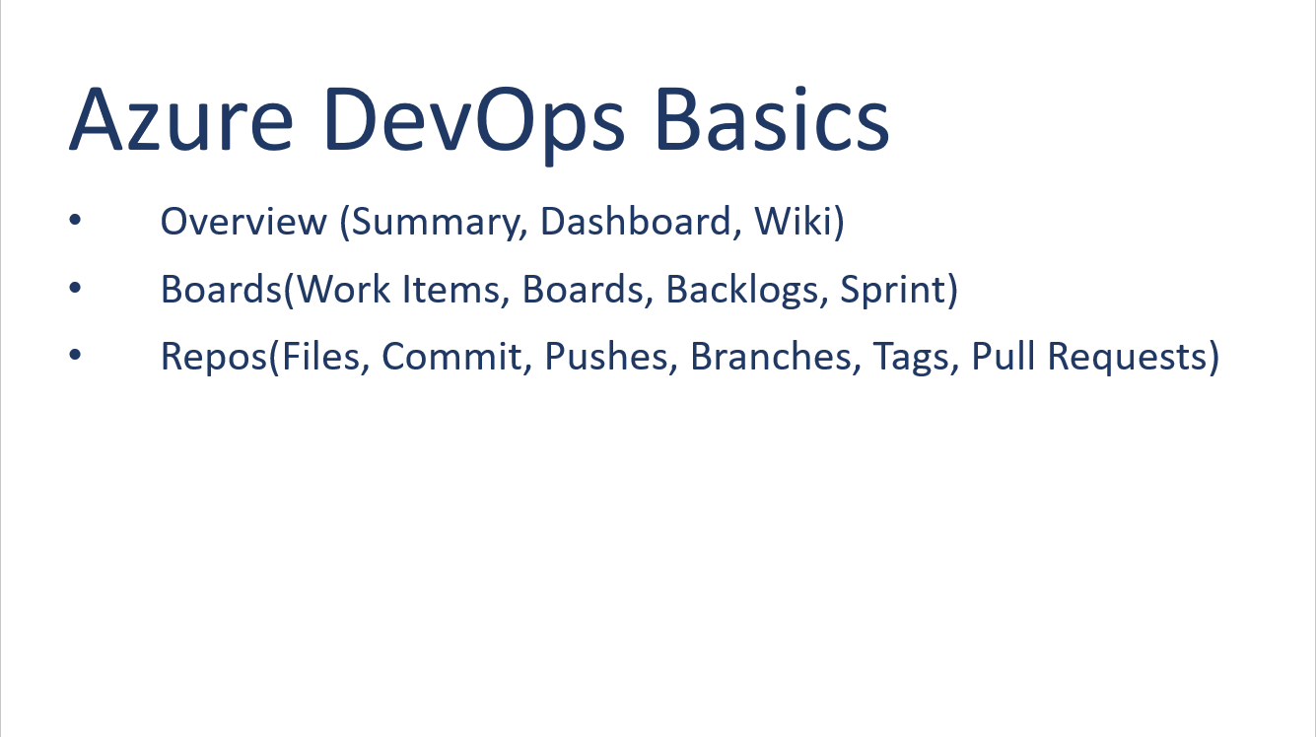

Slide 5
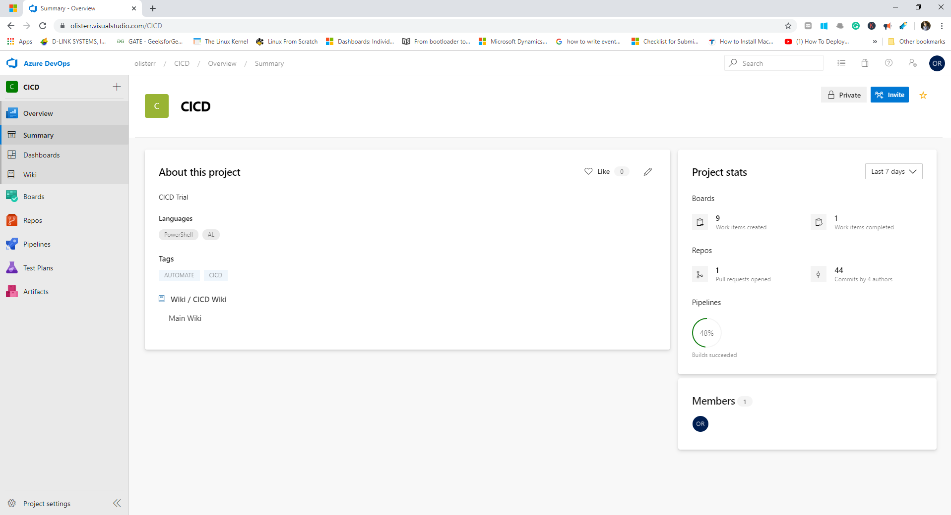
Azure DevOps – Overview - Summary

Slide 6
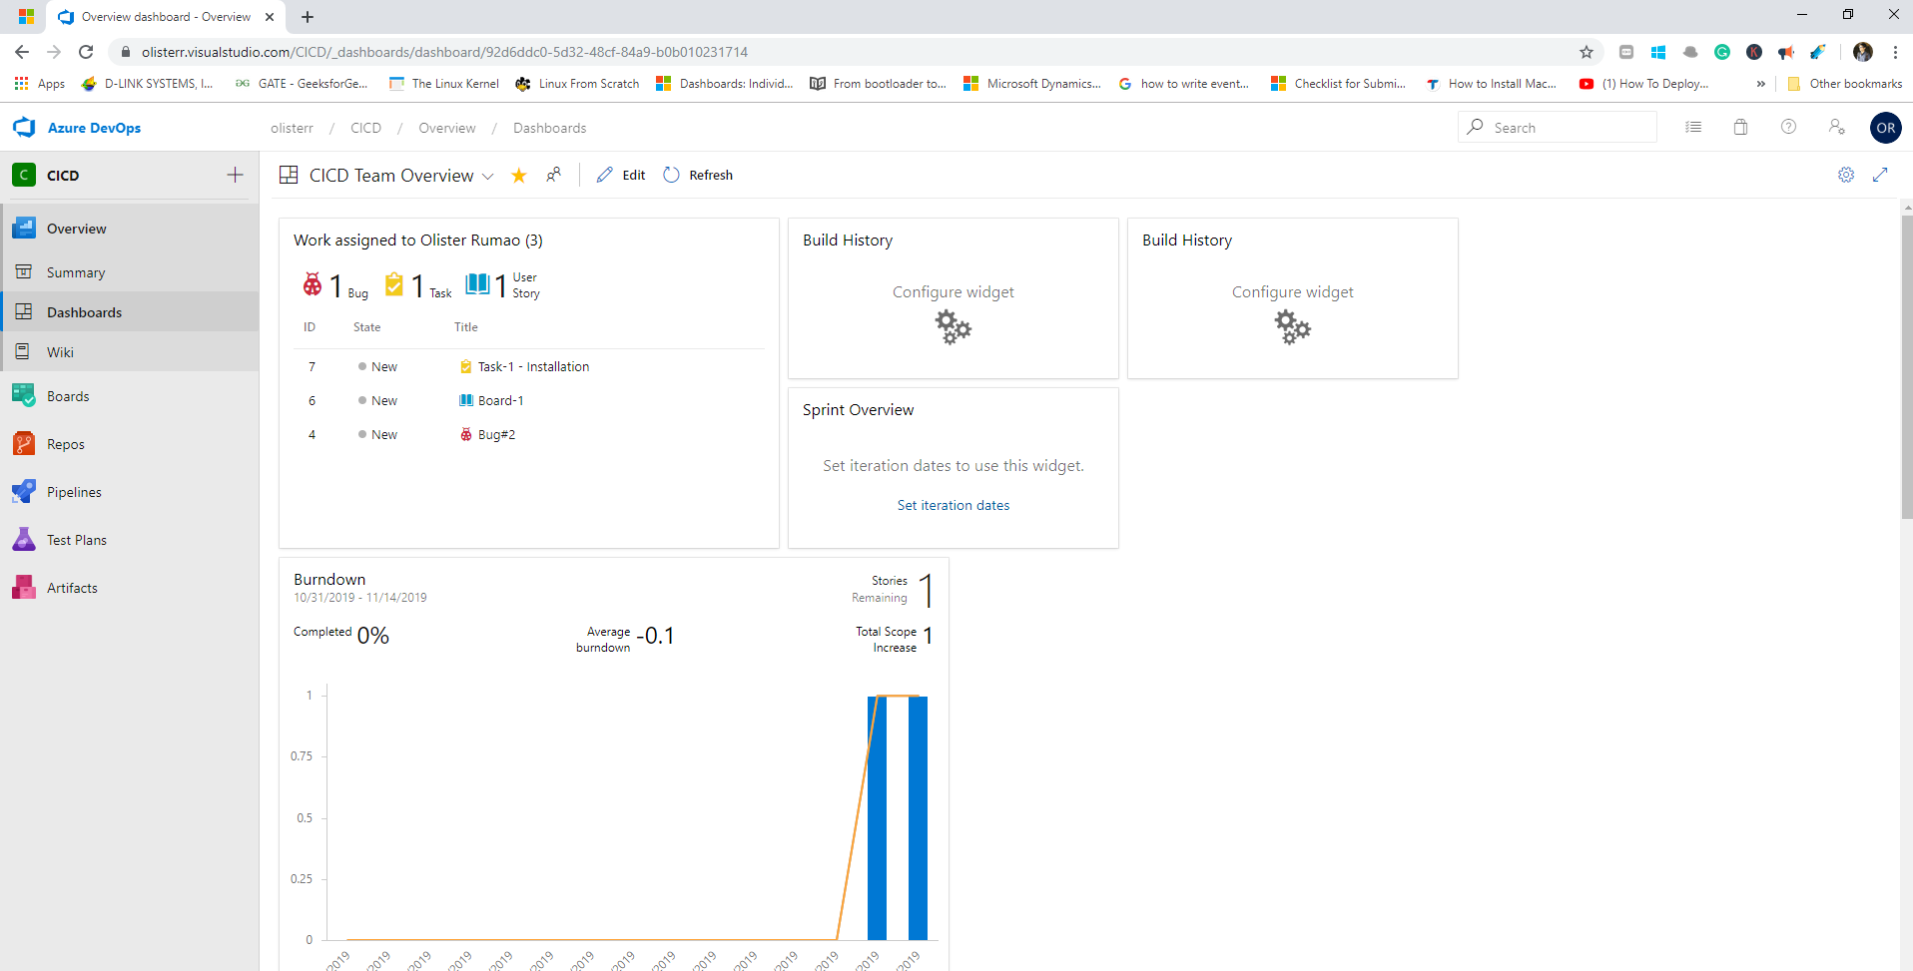
Azure DevOps – Overview - Dashboards

Slide 7
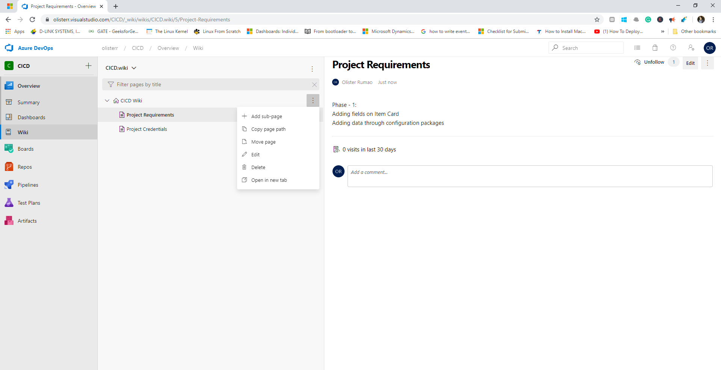
Azure DevOps – Overview - Wiki

Slide 8
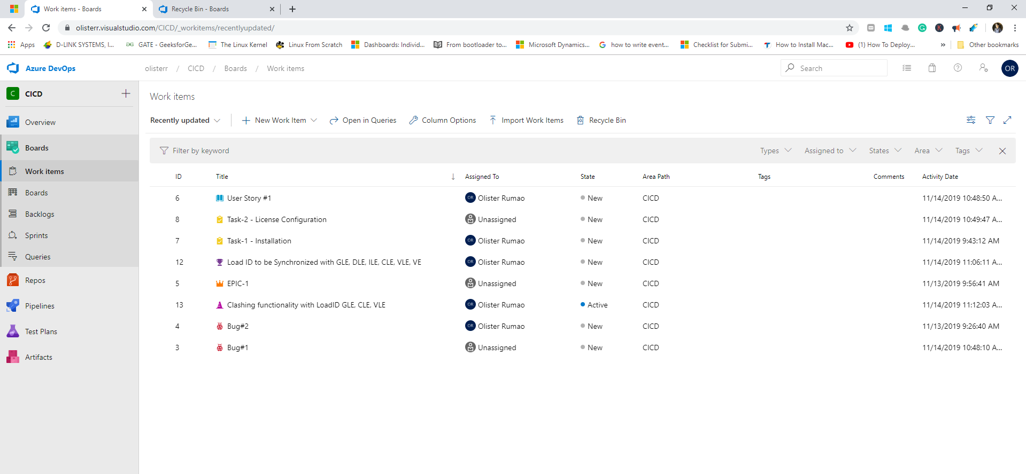
Azure DevOps - Boards - Work Items

Slide 9
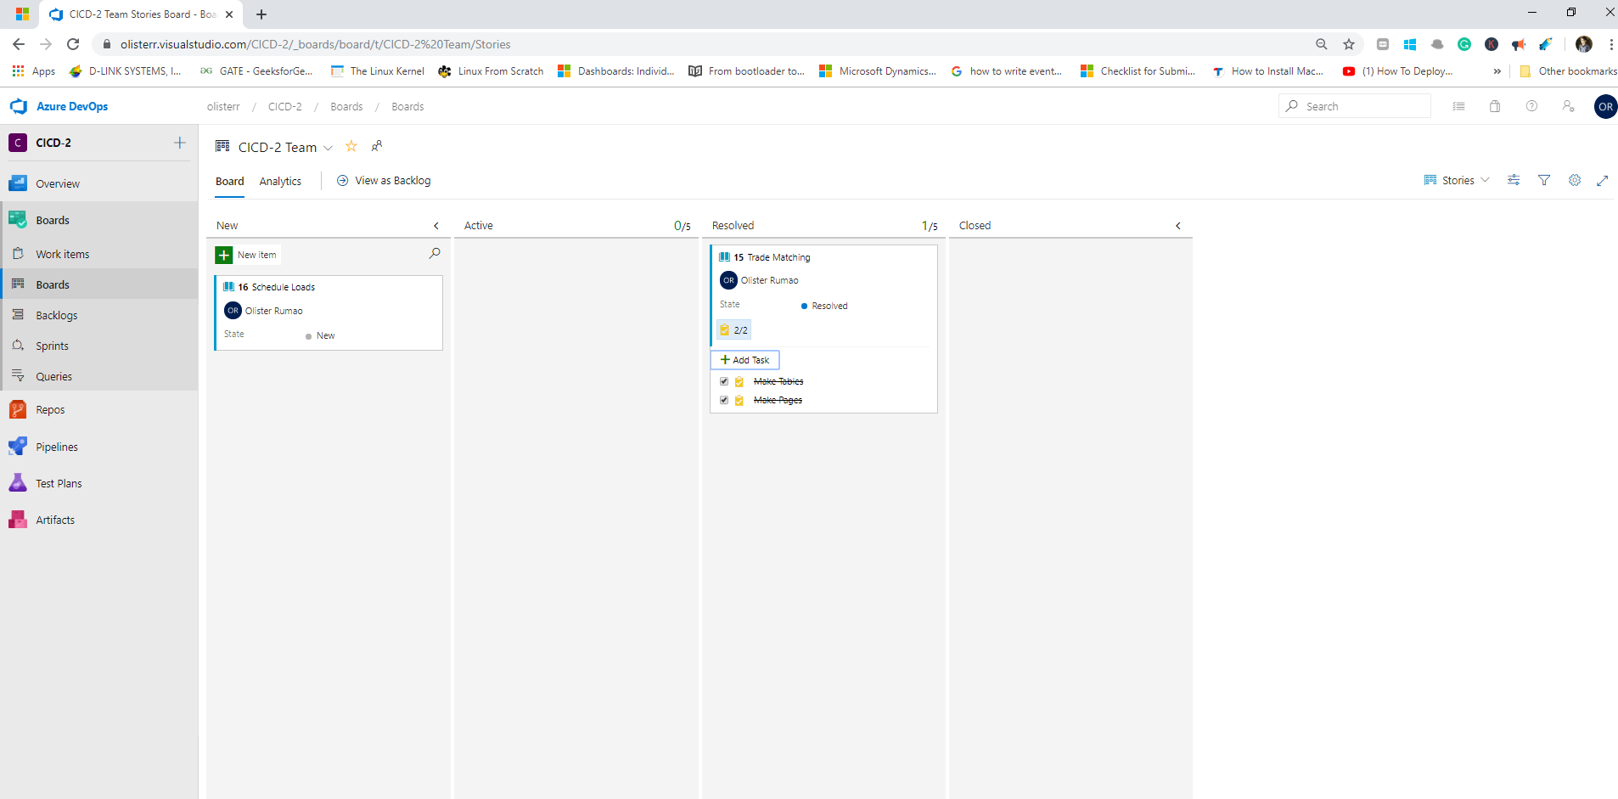
Azure DevOps - Boards - Boards

Slide 10
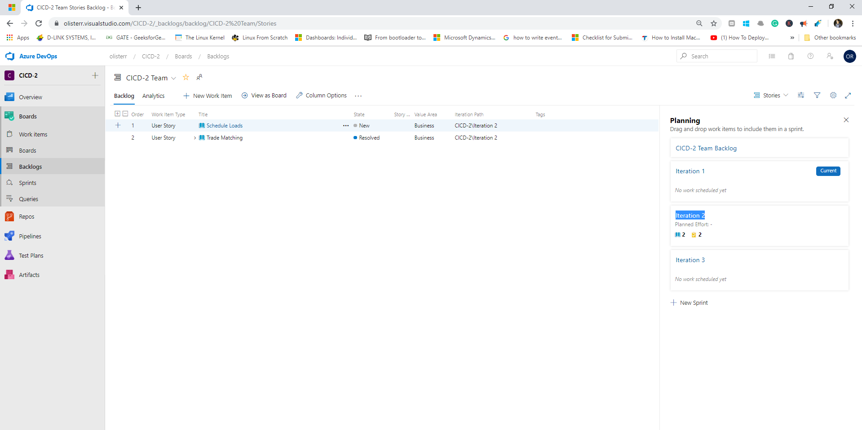
Azure DevOps - Boards - Backlogs

Slide 11
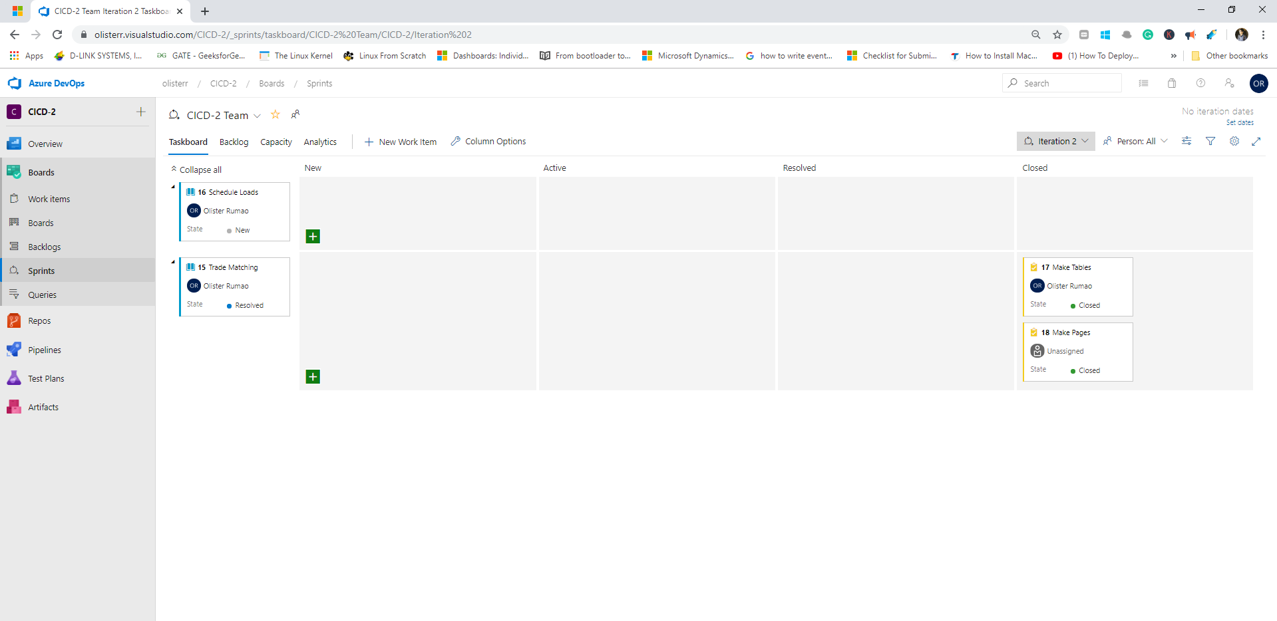
Azure DevOps - Boards - Sprints

Slide 12
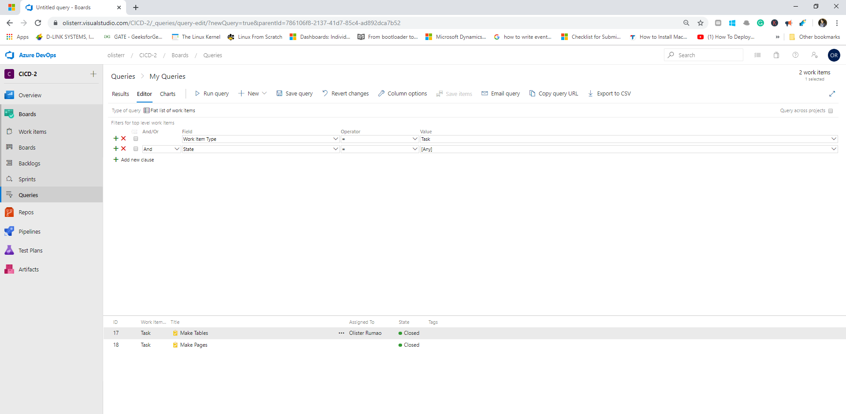
Azure DevOps - Boards - Sprints

Slide 13
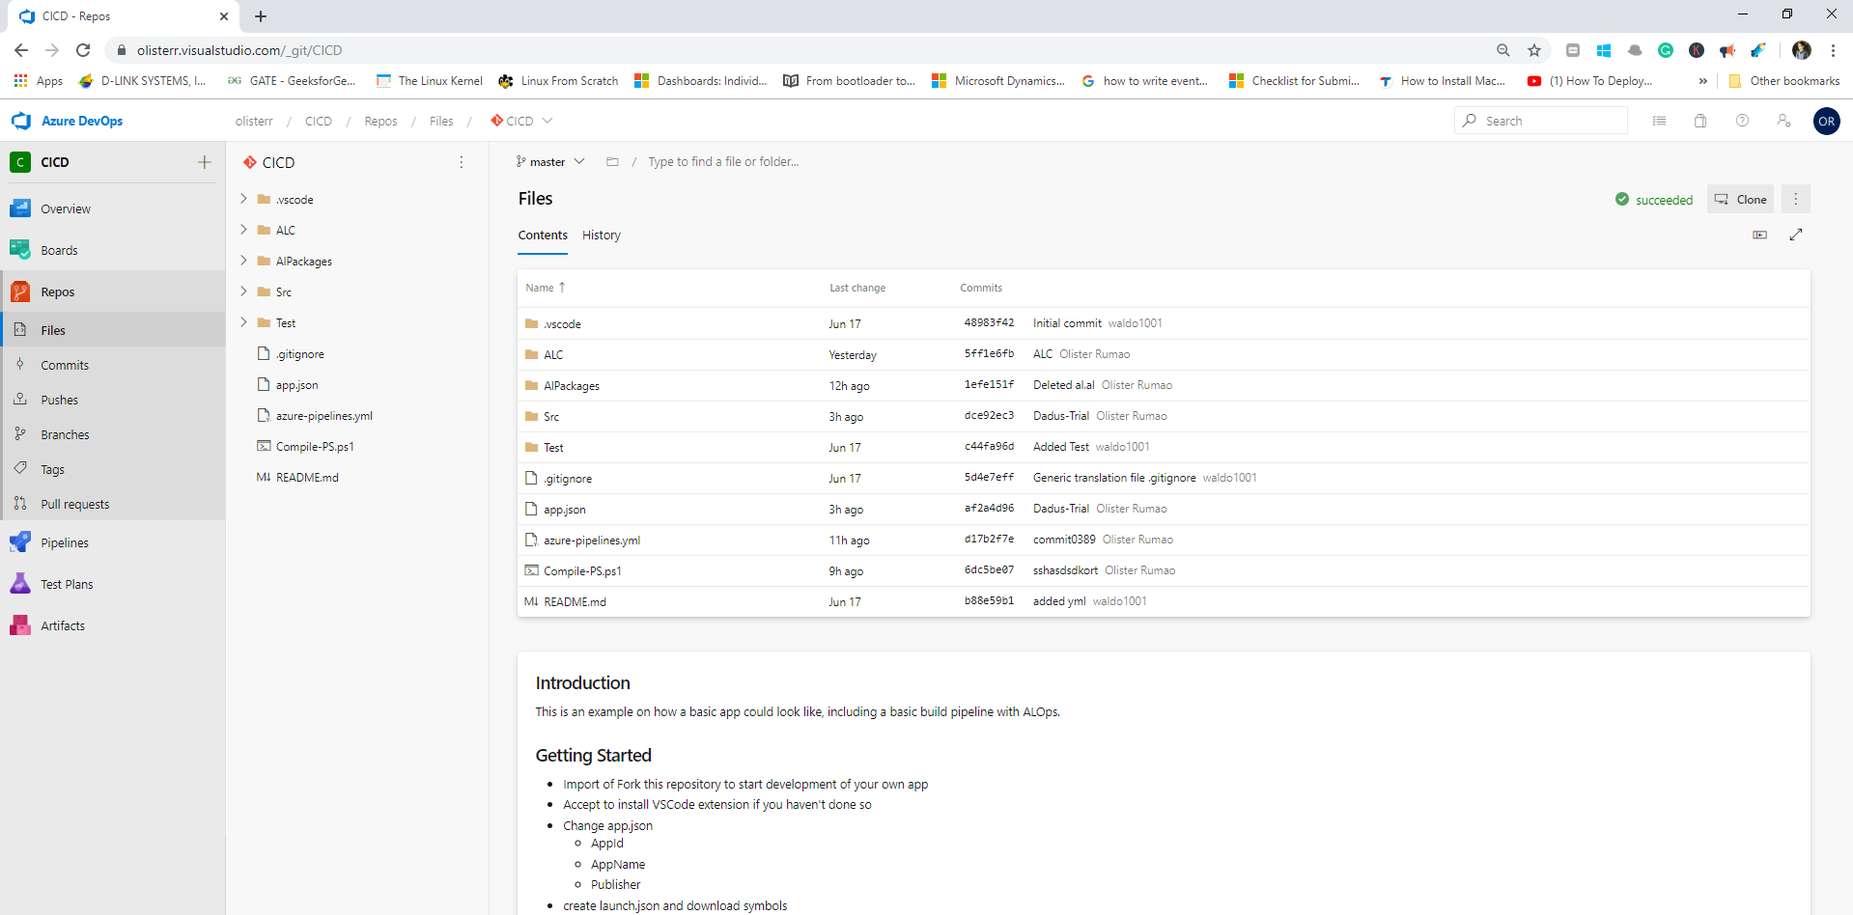
Azure DevOps – Repos - Files

Slide 14
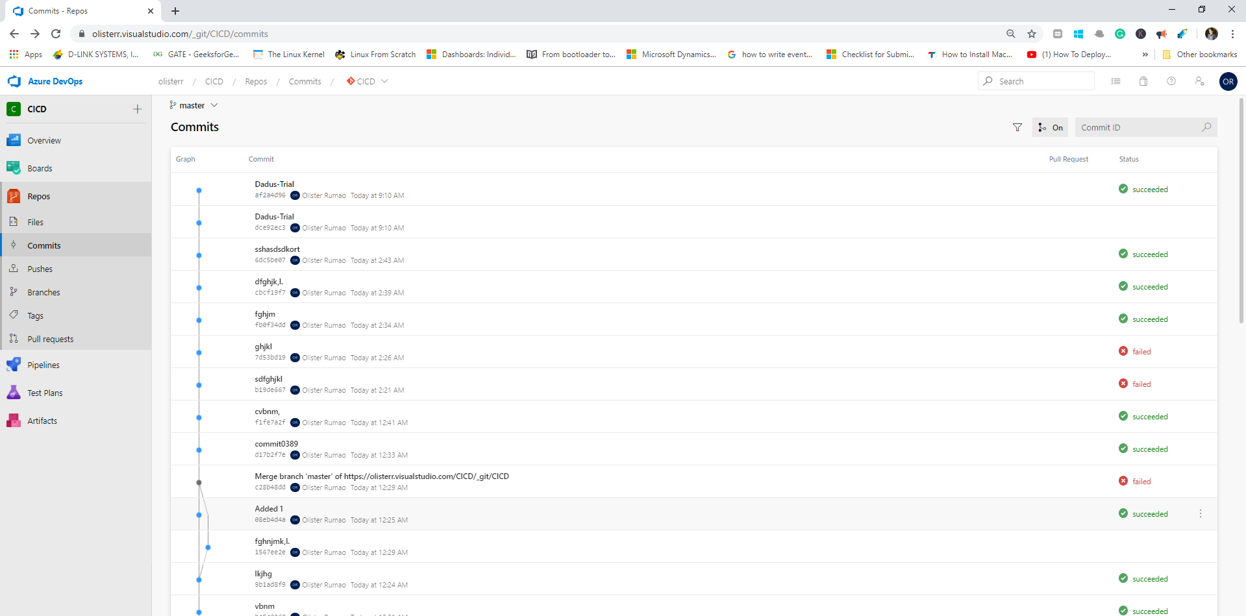
Azure DevOps – Repos - Commits

Slide 15
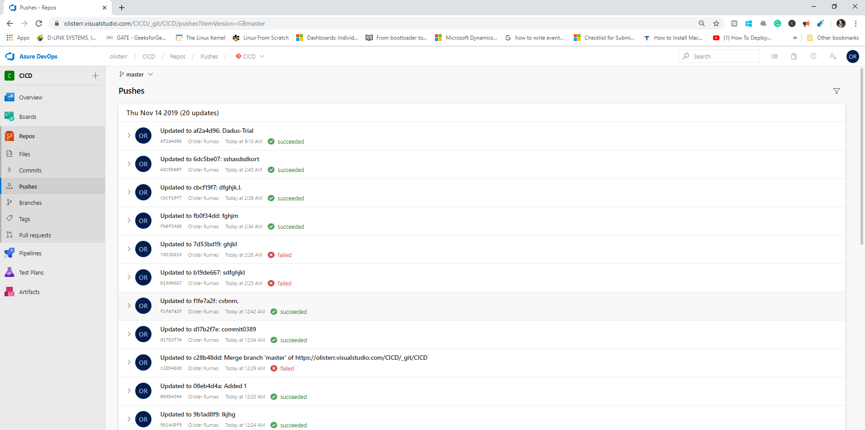
Azure DevOps – Repos - Pushes

Slide 16
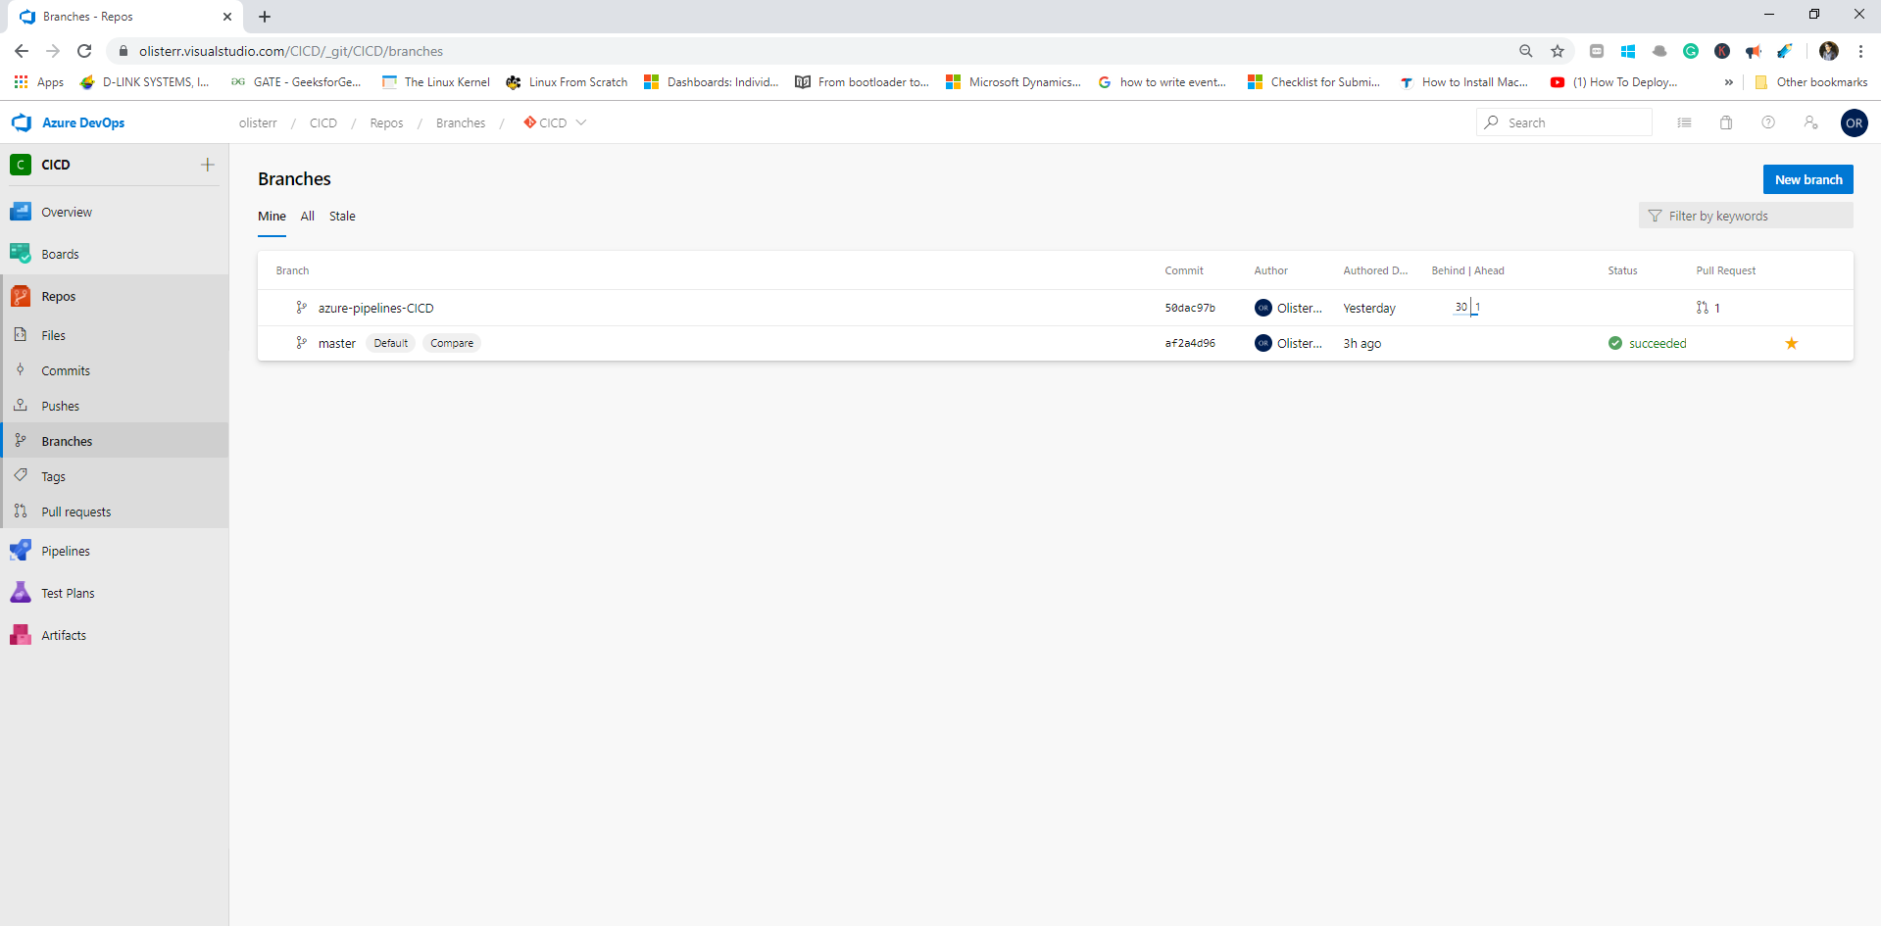
Azure DevOps – Repos - Branches

Slide 17
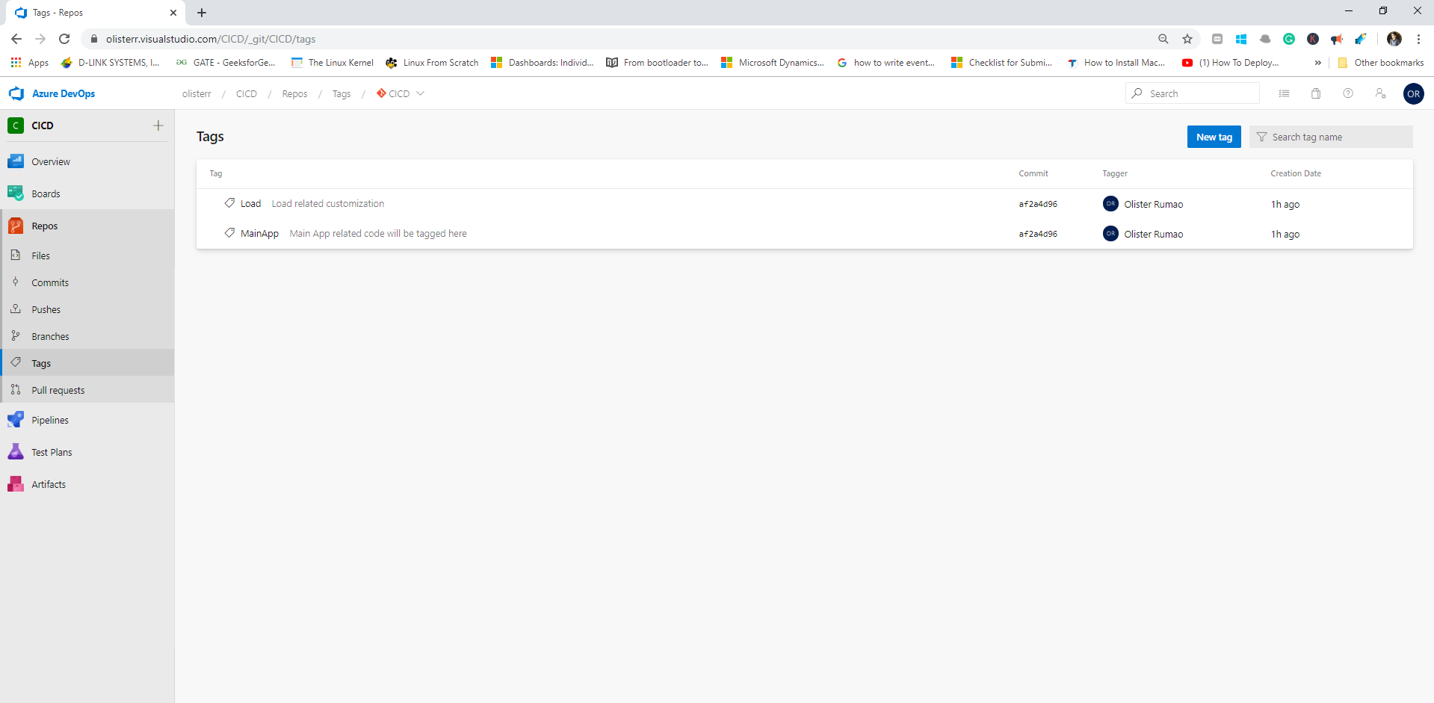
Azure DevOps – Repos -Tags

Slide 18
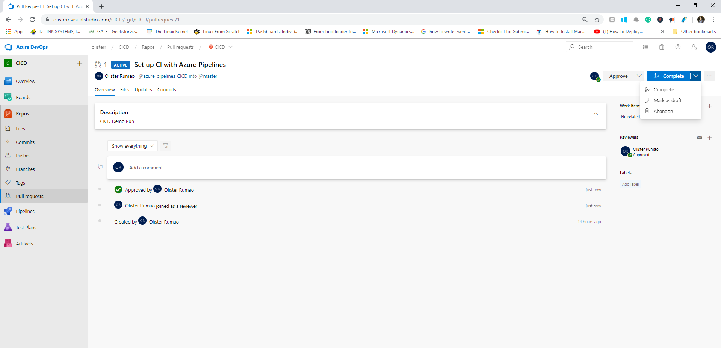
Azure DevOps – Repos – Pull requests

Slide 19
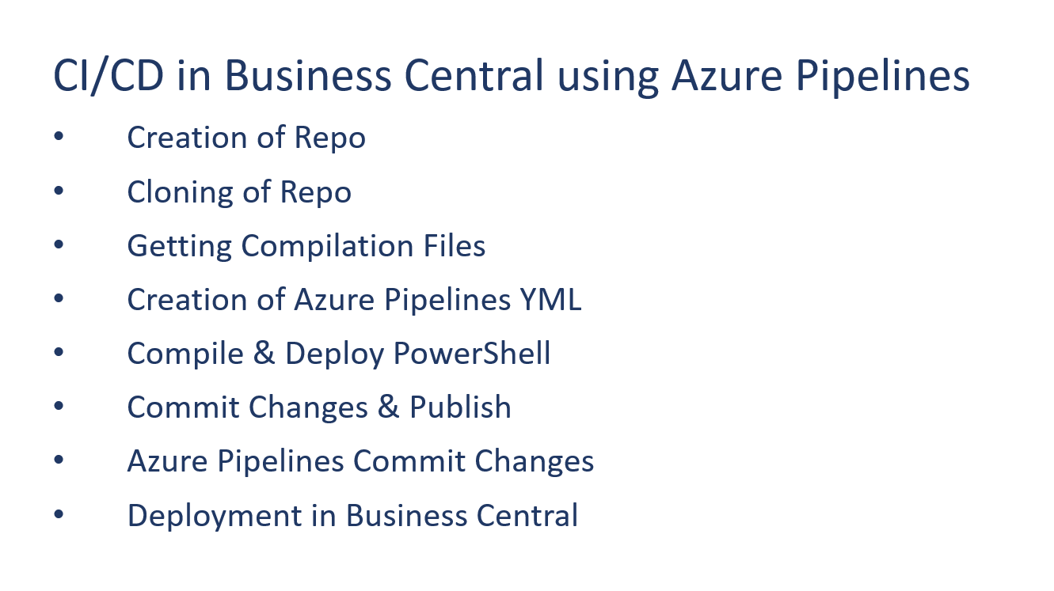
CI/CD in Business Central using Azure Pipelines

Slide 20
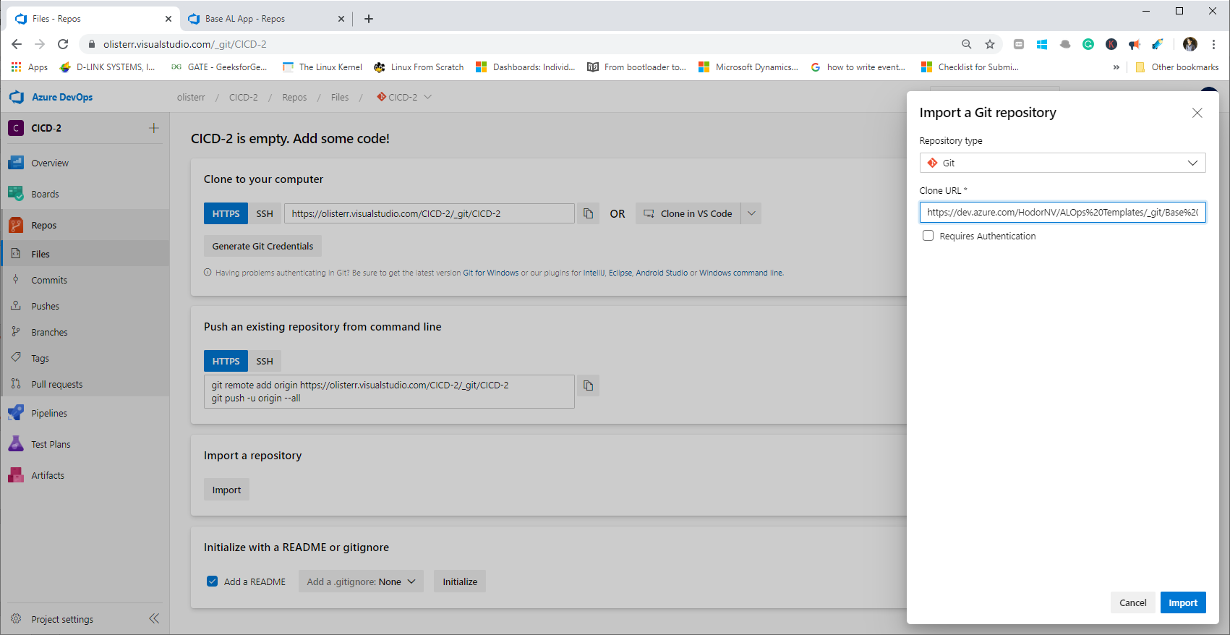
CI/CD using Azure Pipelines – Creation of Repo

Slide 21
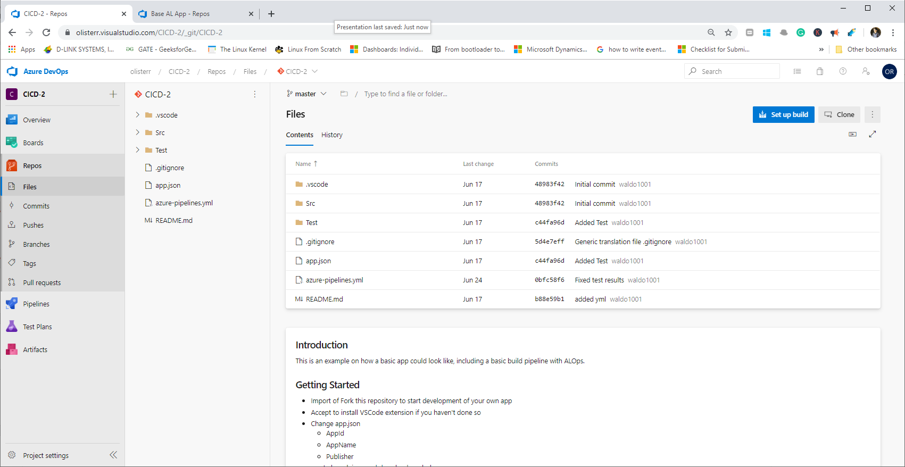
CI/CD using Azure Pipelines – Creation of Repo - Clone

Slide 22
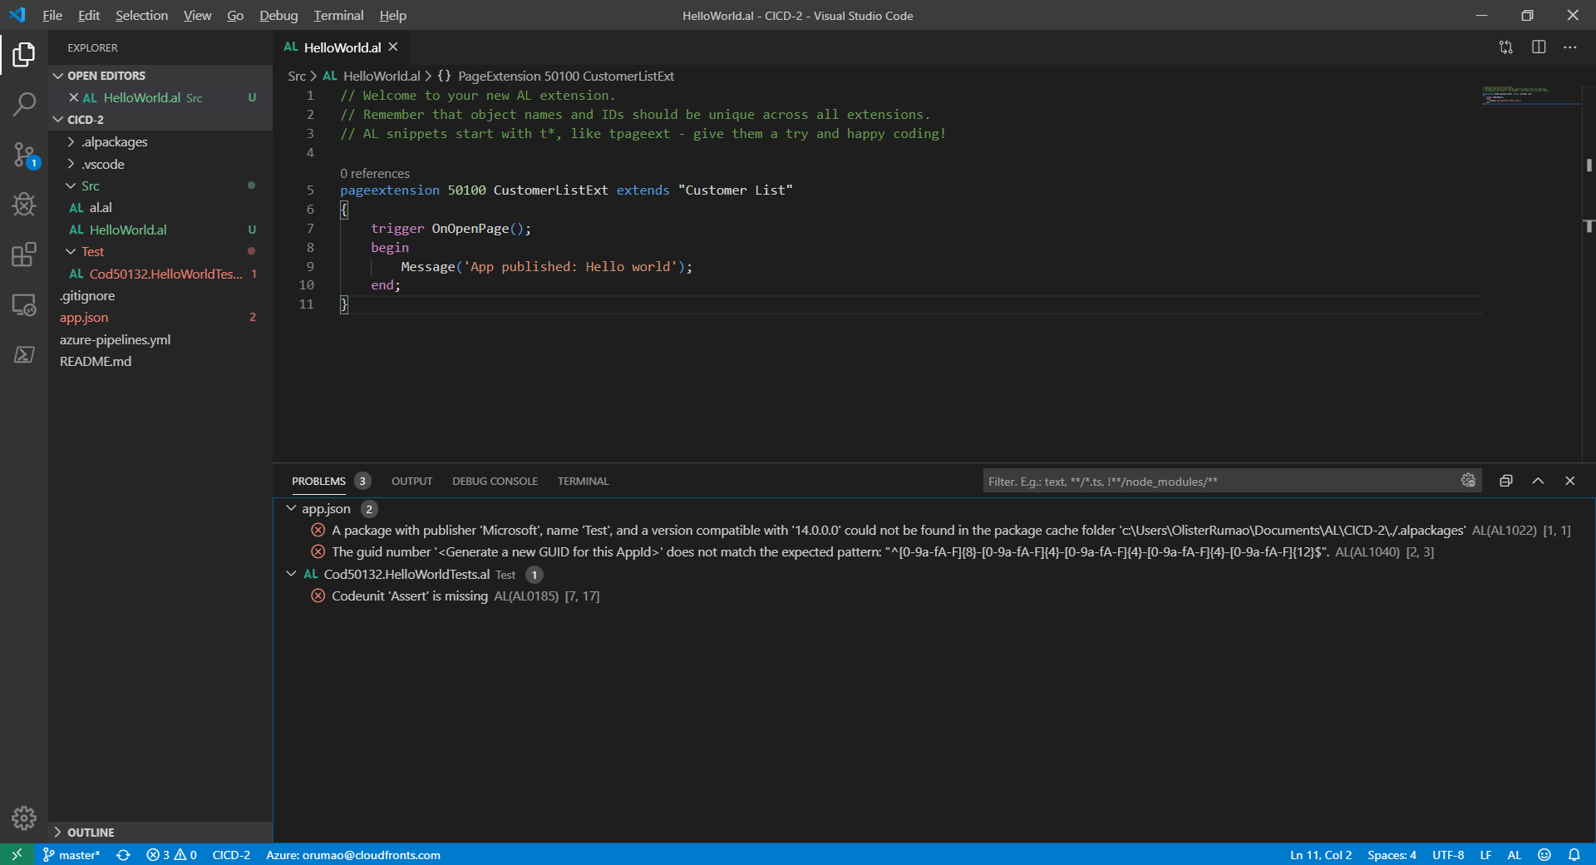
CI/CD using Azure Pipelines – Creation of Repo - VS Code Clone

Slide 23
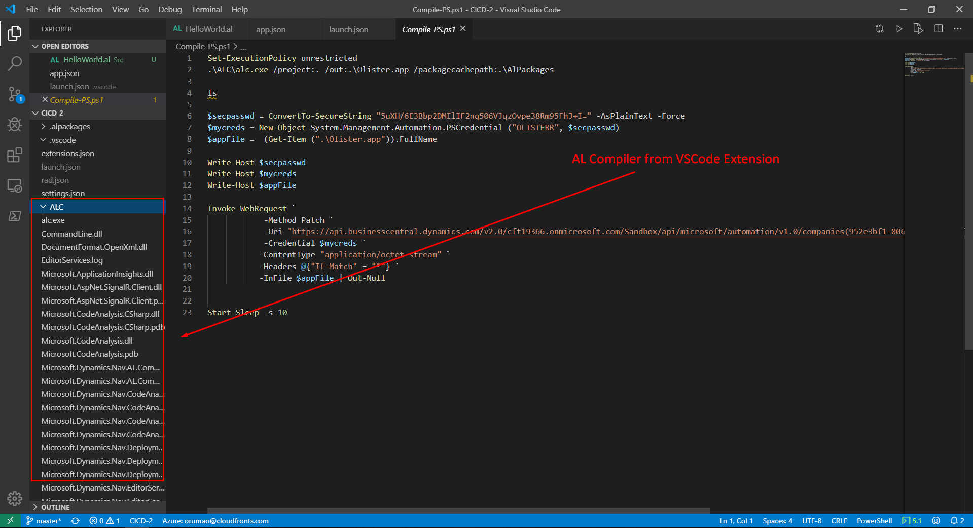
CI/CD using Azure Pipelines – Get Appropriate Files

Slide 24
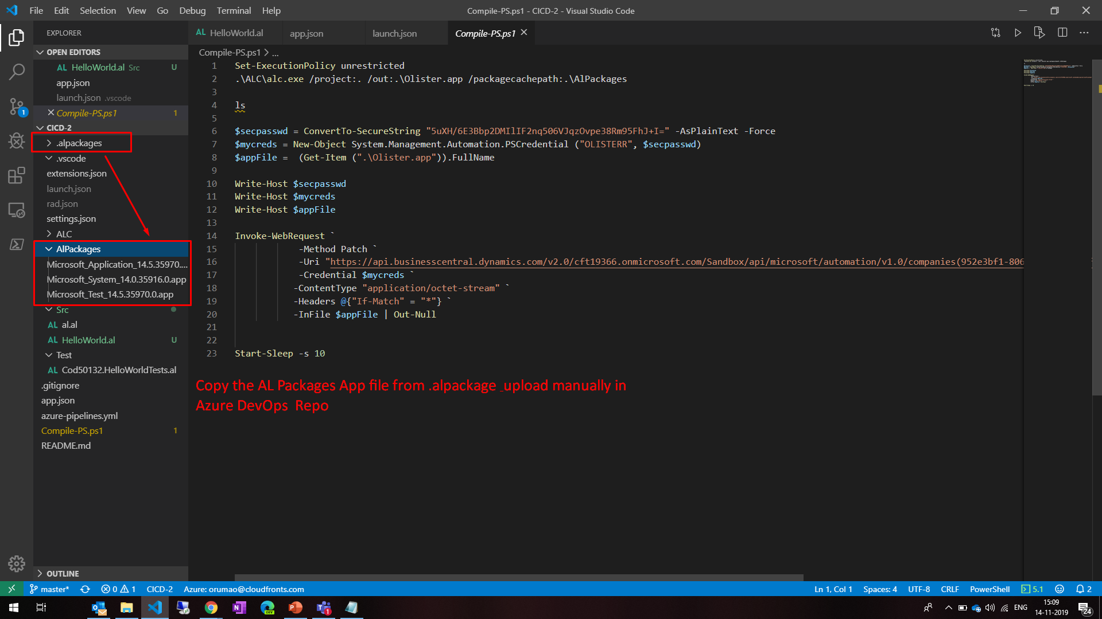
CI/CD using Azure Pipelines – Creation of Compilation Symbols

Slide 25
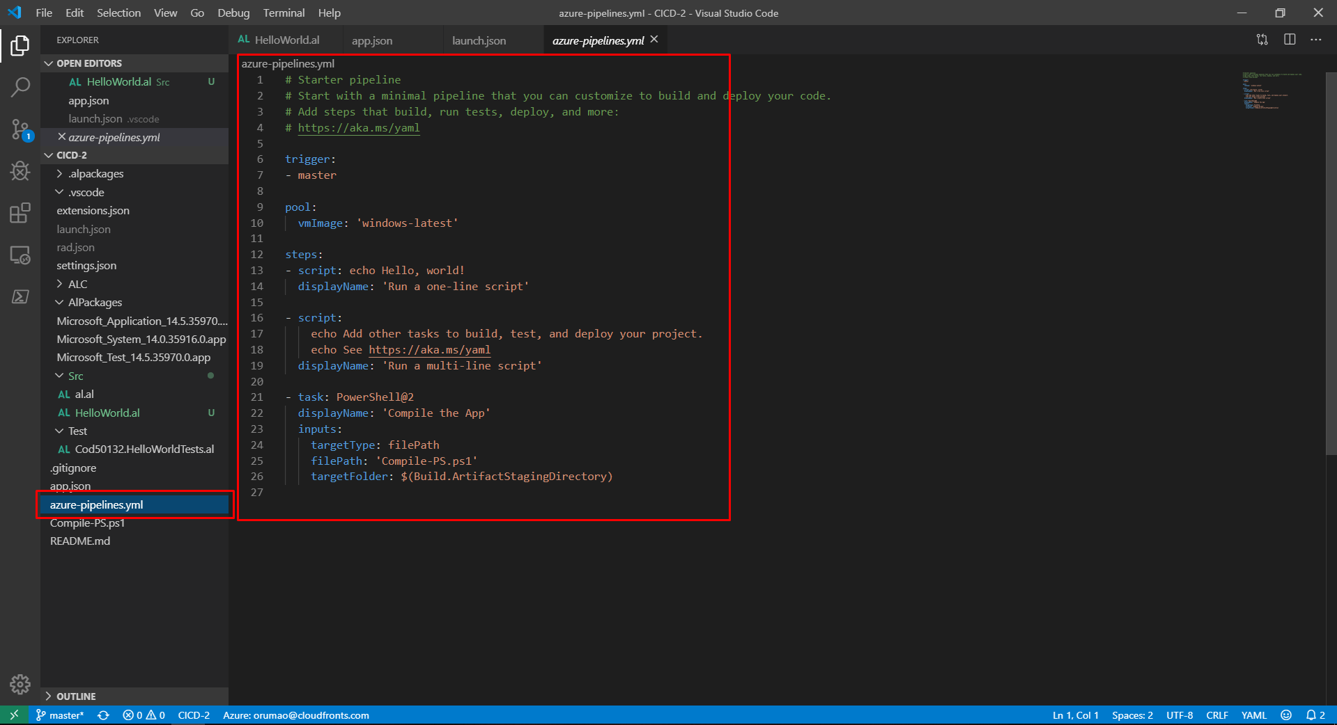
CI/CD using Azure Pipelines – Creation of azure-pipelines.yml

Slide 26
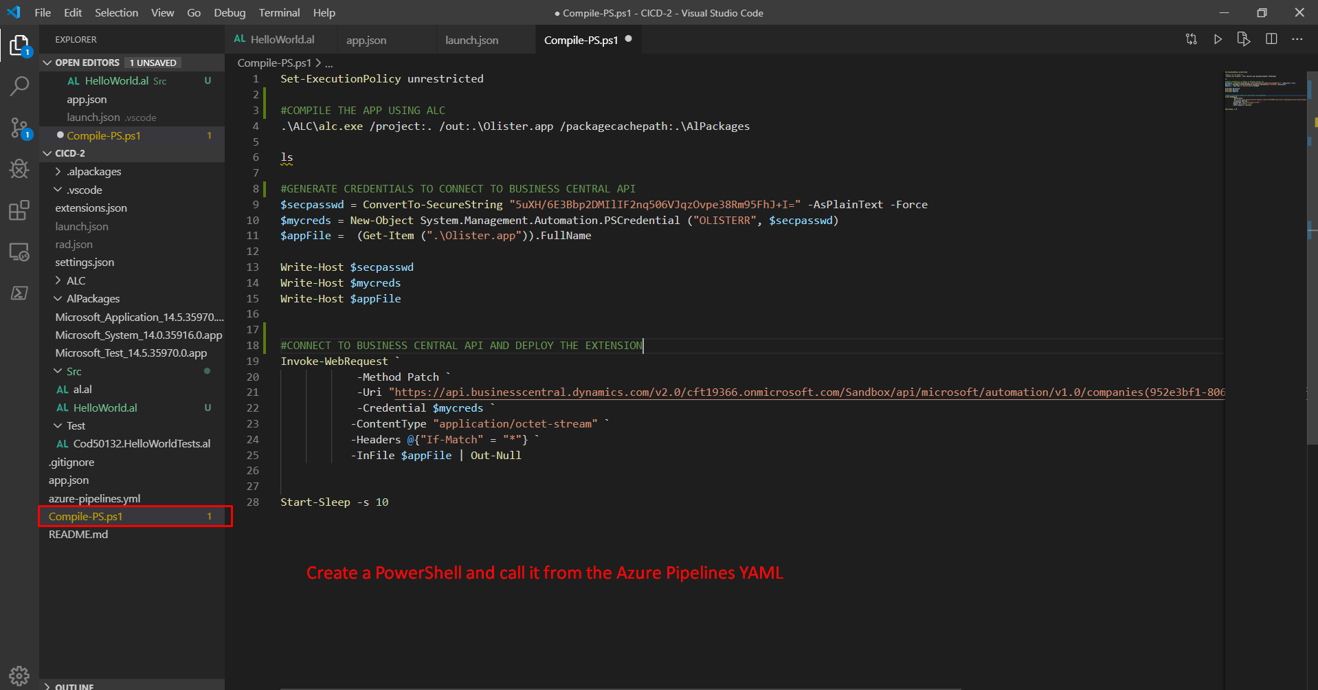
CI/CD using Azure Pipelines – Creation of Compile & Deploy PS

Slide 27
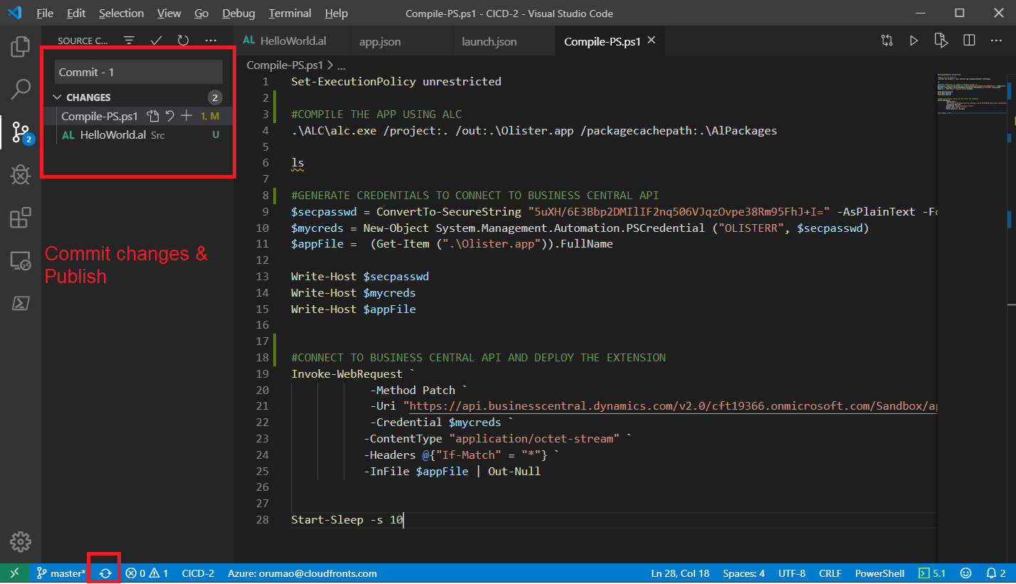
CI/CD using Azure Pipelines – Commit changes & Publish

Slide 28
CI/CD using Azure Pipelines – Commit changes & Publish

Slide 29
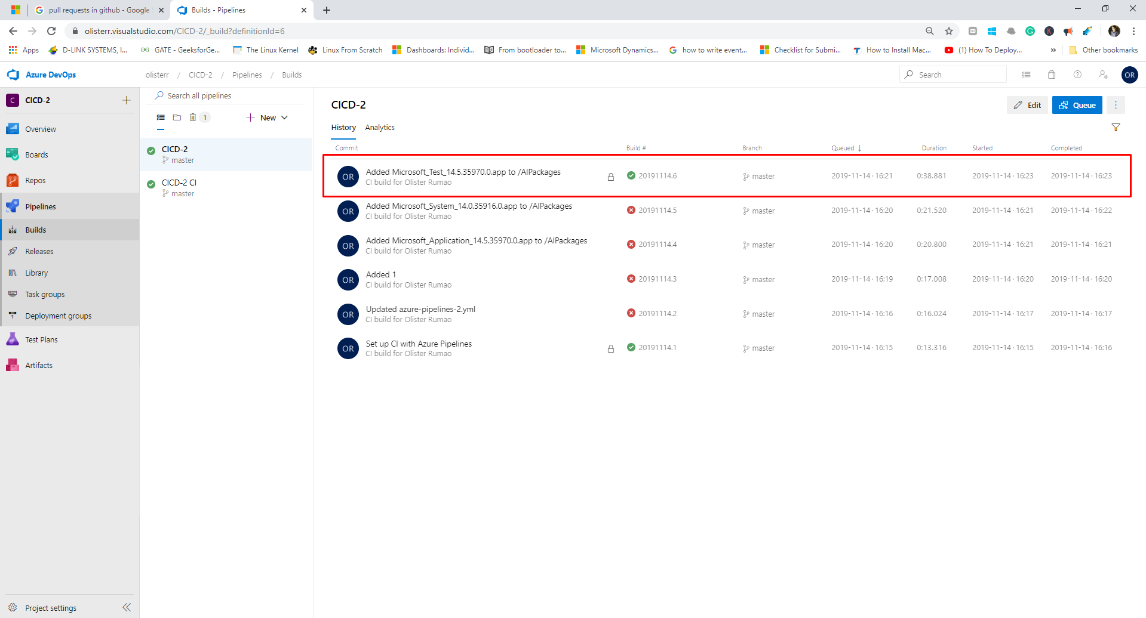
CI/CD using Azure Pipelines – Commit changes & Publish

Slide 30
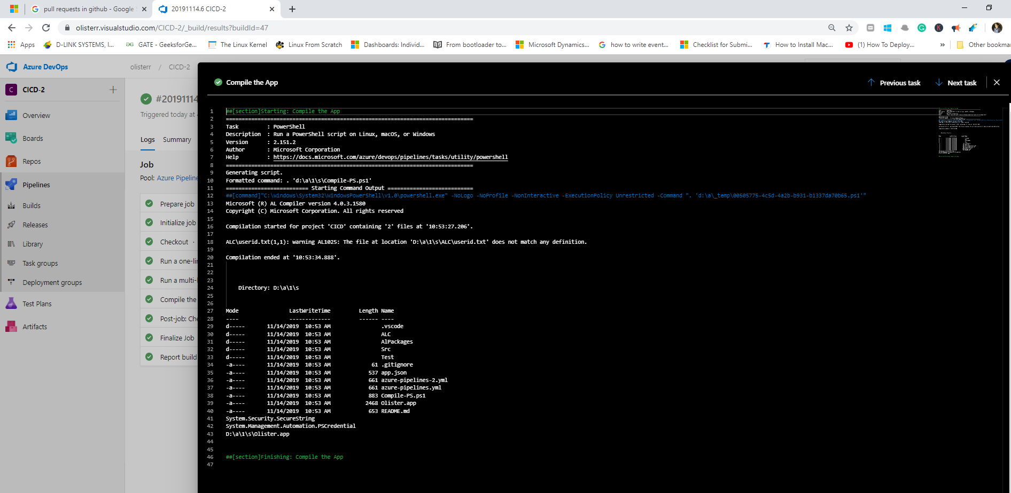
CI/CD using Azure Pipelines – Commit changes & Publish

Slide 31
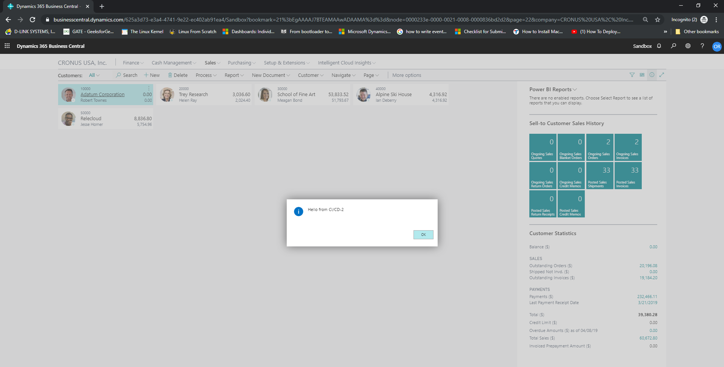
CI/CD using Azure Pipelines – Commit changes & Publish

Slide 32


Slide 33
Blog: https://olisterr.tech/

